Slide 1
Distributed coordination and synchronization:
Distributed mutex, distributed election, distributed consensus, distributed transaction, distributed locks
Distributed management and resources
Centralized structure, decentralized structure, scheduling
Distributed computation
MapReduce, Spark
Distributed communication
RPC, publish and subscribe, message queue
Distributed storage
CAP, distributed storage, distributed cache

Slide 2
CS 7172 Parallel and Distributed Computation Distributed Mutex and Election
Kun Suo
Computer Science, Kennesaw State University
https://kevinsuo.github.io/

Slide 3
What is Distributed Mutex?
Suppose you are making coffee at Starbucks, and someone takes away your cup, some other takes away the coffee machine
Ideal: you want to keep using the machine and cup without interference

Slide 4
What is Distributed Mutex?
Like the coffee machine, in distributed system, for the same shared resource, one program does not want to be disturbed by other programs while it is being used.
This requires that only one program can access this resource at a time

Slide 5
What is Distributed Mutex?
In a distributed system, the method to achieve access to exclusive resource is called Distributed Mutual Exclusion
The shared resource that is accessed by mutual exclusion is called Critical Resource

Slide 6
Method 1: Centralized algorithm
Add a "Coordinator" to restrict everyone to use self-service coffee machines in order to solve the problem of forcibly interrupting others

Slide 7
Method 1: Centralized algorithm
Centralized algorithm is also named as Central Server algorithm in distributed system
Coordinator
Currently using
Program 3
Program 1
Request queue
Program 2
Program 4
Program 3
Program 2
Program 4

Slide 8
Method 2: Distributed algorithm
Do you use the coffee machine right now?
When you need to use a self-service coffee machine, you can ask other people first. When confirming that no other people are using, you can make your coffee.

Slide 9
Method 2: Distributed algorithm
Request queue in P1
Program 1
Resource A
A, 1, t₁
A, 1, t₁
Program 2
Program 3
A, 3, t₂
Request queue in P2
Request queue in P3

Slide 10


Method 3: Token Ring Algorithm
How token ring algorithm works?
All programs form a ring structure. Tokens are passed between programs in a clockwise (or counterclockwise) direction.
The program that receives the token has the right to access critical resources. After the access is completed, the token is transferred to the next program.
If the program does not need to access critical resources, just passes the token to the next program
1
Token
N
2
4
3

Slide 11
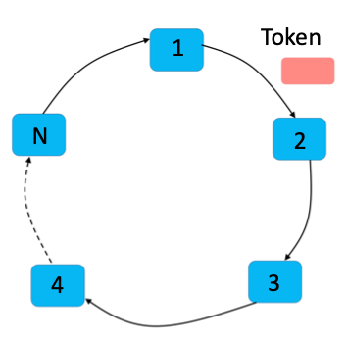
Scenario using Token Ring Algorithm
Walkie-talkie:
Can send or receive messages
Every time only one walkie-talkie can send
The walkie-talkie that holds the token can send and others just receive

Slide 12
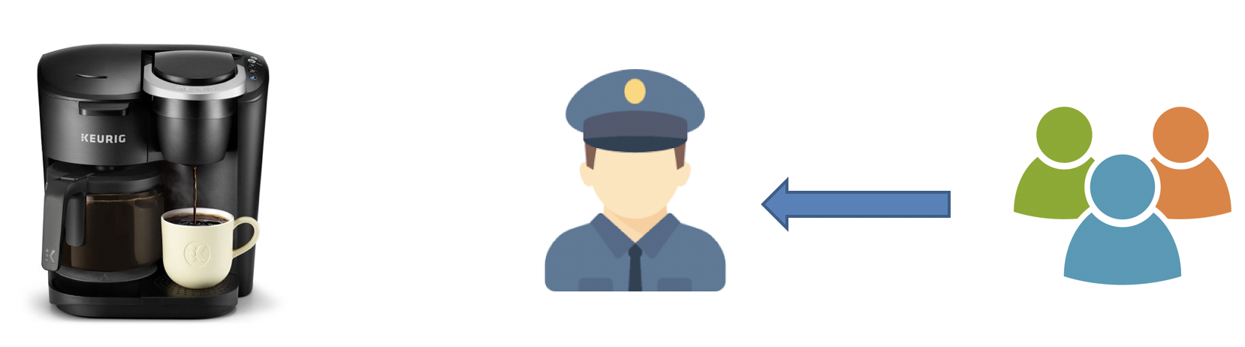
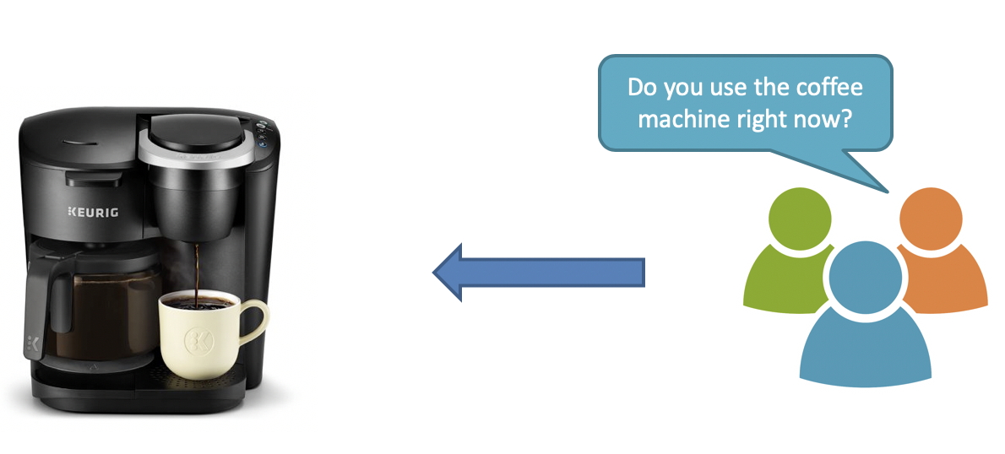
Distributed Mutex
Centralized algorithm
Distributed algorithm
Token Ring Algorithm

Slide 13
Why we need Distributed Election?
Master node is so important in distributed system
Scheduling and managing other nodes
What will happen when the master node crashed?

Slide 14
1. Bully algorithm
Nodes have two types: normal nodes and master nodes.
During initialization, all nodes are normal nodes, and have the right to become masters. However, after the election, only one node becomes the master node, and all other nodes are normal nodes. The node with the highest ID number from amongst the non-failed nodes is selected as the coordinator.
The master will be reelected if and only if the master node fails or loses connect with other nodes.

Slide 15
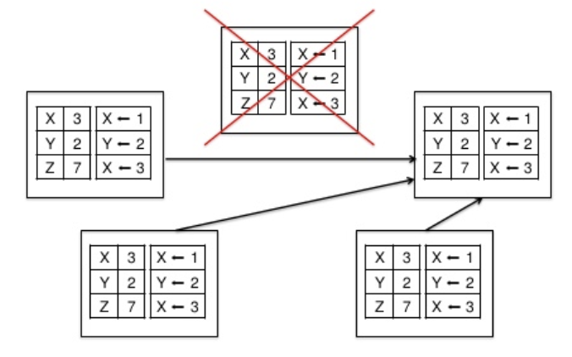
Bully algorithm example in MongoDB
How MongoDB deals with failure:
The node's last operation timestamp is used to represent the ID
The node with the latest timestamp has the largest ID, thus the live node with the latest timestamp is the master node

Slide 16
1. Bully algorithm
Advantages:
Fast election speed
low algorithm complexity
simple and easy to implement (who lives and who has the largest ID is the master node)

Slide 17
1. Bully algorithm
Disadvantages:
Each node needs to have global node information (all node IDs), so additional information needs to be stored.
New election is required when any new node that is larger than the current master node ID
Frequent switch over could happen when some nodes frequently join and exit the cluster

Slide 18
2. Raft algorithm
Similar as the democratic voting
The core idea is "the minority obeys the majority"
The node with the most votes becomes the master node

Slide 19
Raft algorithm example in Kubernetes
How Kubernetes deals with data failure:
To ensure reliability, N nodes are usually deployed for data backup. One of the three nodes will be selected as the master, and the other nodes will be used as backups.
Leader
Follower

Slide 20
2. Raft algorithm
Advantages:
Fast election speed
low algorithm complexity
simple and easy to implement (who lives and who has the half votes is the master node)

Slide 21
2. Raft algorithm
Disadvantages:
It requires that each node in the system can communicate with each other (vote), and requires the node which has more than half of the votes to be the master, thus the communication traffic is large

Slide 22
Comparison
 | Bully | Raft
How to elect leader | Largest ID | Get half of the votes
How the algorithm works | When nodes find no responses from leader or leader fails, raise new election | Every node can be Candidate and selected as Leader. Every follower can only vote once in every election.
Election time | Short | Long
Performance | Bully < Raft

